Slide 1
Dev-Ops Capstone
Notes:
Hi my name is mikesh and today I will be presenting my DevOps capstone project.
Please see the chat for a copy of the hand out.

Slide 2

What’s on the agenda?
User Story
Design
Design tools & code
Demonstration
Next Steps – Azure
Source code
CI/CD Pipeline &Artifacts
Summary
Future Improvements
For my Q&A policy please wait until the questions slides and the set intervals during the presentation
Notes:
So on the Agenda today we have our user story which I will be using as a reference through the presentation.
I’ll then briefly walk you through some of the tools that I used for the project and explain some of the code used.
After that we will move on to a live demo where I will show a image being built and then the container that can then be run using that newly bulilt image.
I will then discuss how the project could be migrated to azure devops and how this would manage source code, CI/CD piplines and artifacts.
Then a quick summary and the future improvements for the project.
For my Q&A policy please wait until the questions slides and the set intervals during the presentation

Slide 3
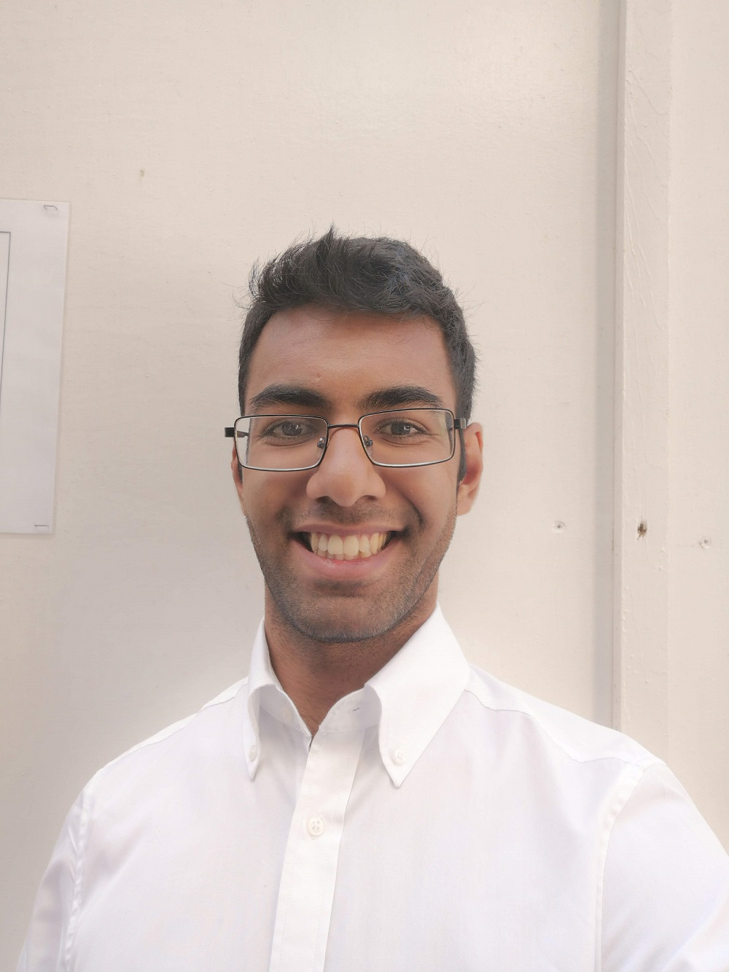
About me
Mikesh Tailor
DevOps Engineer
Experience
Graduated from the University of Essex with a Bsc Computer Science
Currently Training as a DevOps Engineer at WYWM
Personal
I’ve made my passion my Profession
Notes:
So just a little bit about me, My name is Mikesh Tailor. I’m a recent graduate from the uni of essex with a degree in computer Science. Currently im training as a DevOps Engineer at WYWM. I follow this life rule that i heard somewhere once that you should always make your passion your profession cause then work seems like play.
Today I will demonstrating and discussing the project from the perspective of a developer

Slide 4
How can we help you?
Notes:
What do the audience want from this presentation?
If no one answers then
I want to know how to build and run a docker image and containers in order to develop applications

Slide 5
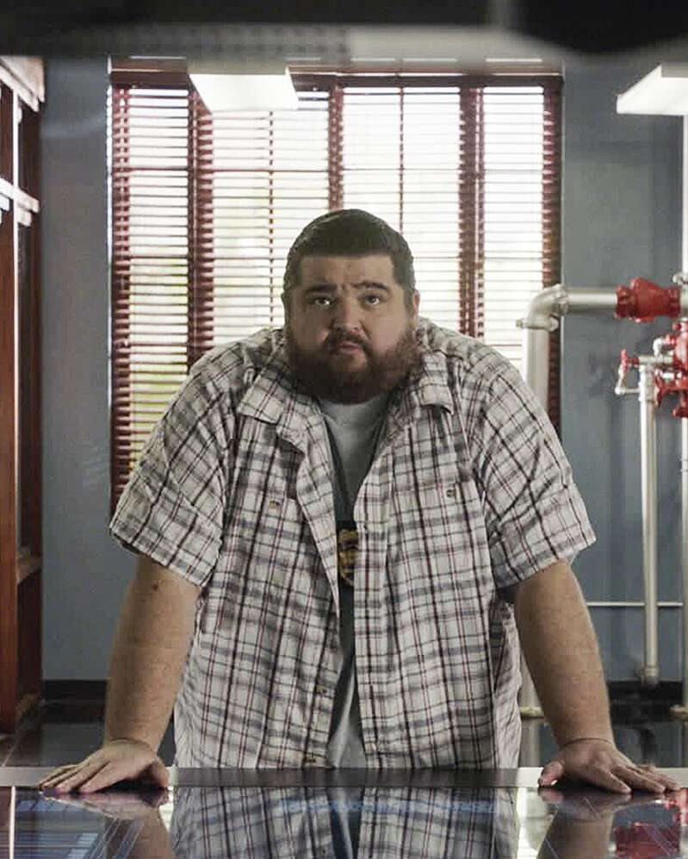
User Story
Jerry is a new developer in a company who has been tasked with creating and deploying applications.
He is interested in using docker
Portability
Jerry is then going to use Azure DevOps as a platform to develop and deploy his application further.
Notes:
He is interested in using docker due to its ability to make applications portable and scalable
Jerry is then going to use Azure DevOps as a platform to develop his application using a CI/CD pipline.

Slide 6
Any Questions?

Slide 7
Project Scope
Build a docker image of Ubuntu server or Alpine server
Create a server with Apache or NGINX
Upload code to the server
Access your site through your new endpoint
Notes:
Read from the slide

Slide 8
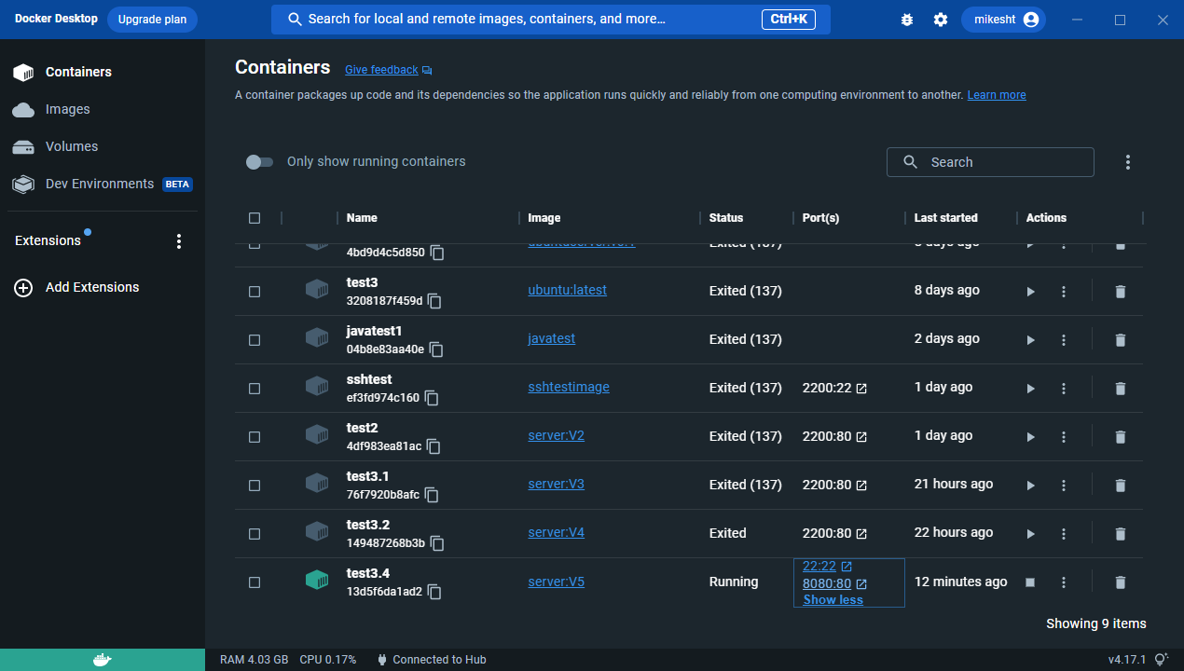
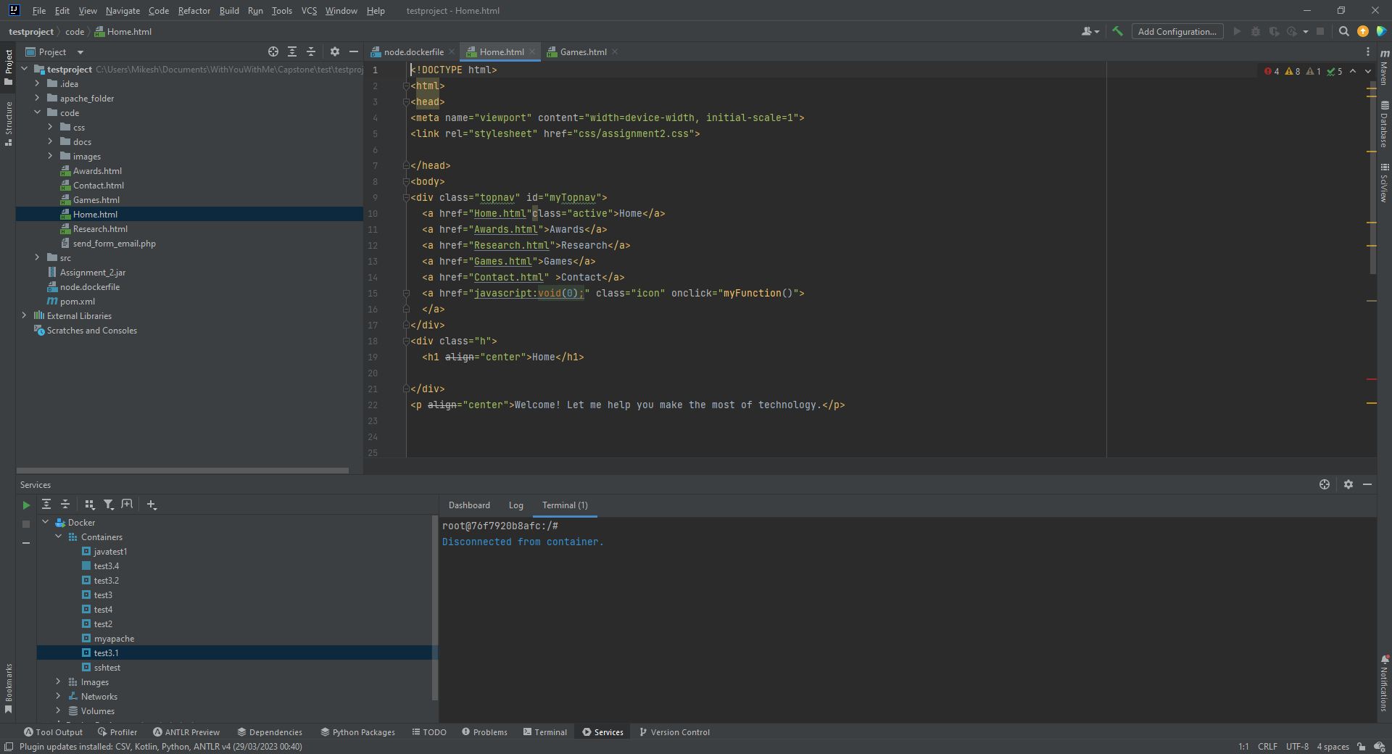
Project Tools
Docker Desktop
IntelliJ
Command Prompt
Notes:
These are the the most common tolls that were used during the project
Docker Desktop provided a good GUI to view images and containers created as well as the ability to start, stop, remove or interact with them.
IntelliJ I used as a Integrated development environment when I was writing the dockerfile and editing the source code.
I also used command promopt so that I could have access to command history to be more efficient.

Slide 9
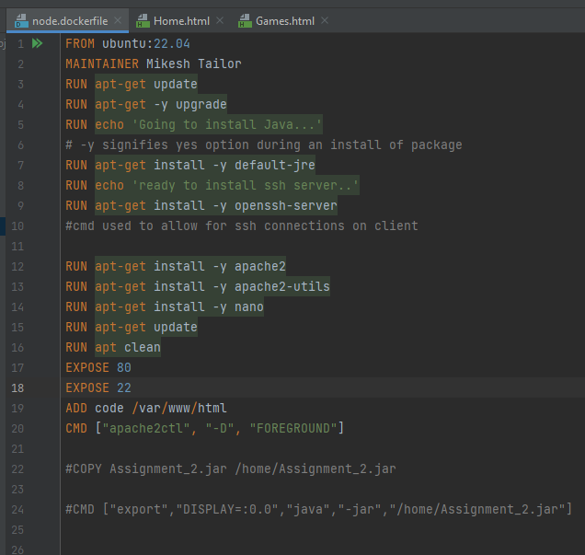
Project Design Back-end
Dockerfile
Notes:
Explain the dockerfile line by line.

Slide 10
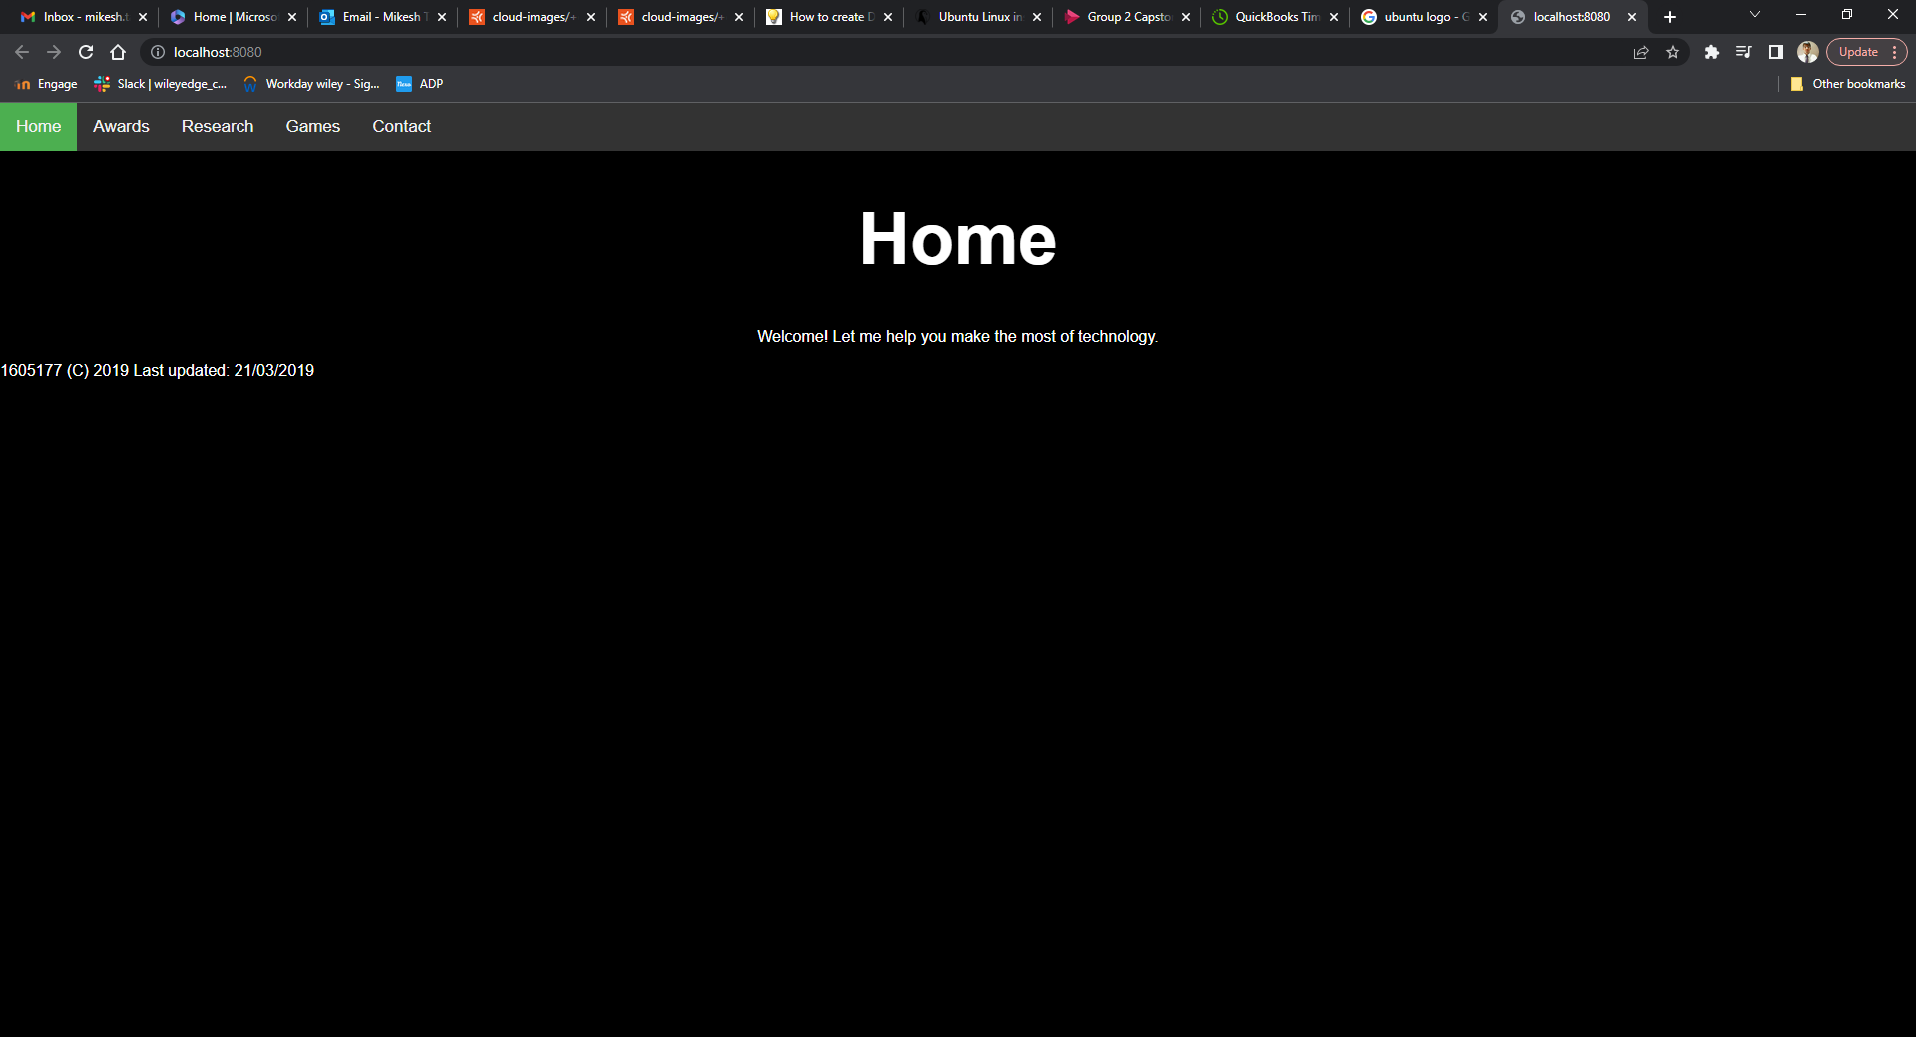
Project Design Front-end
IntelliJ
HTML
CSS
PHP
Notes:
This is just a brief look at the pages, they were composed with basic html code and css also built in IntelliJ

Slide 11
Any Questions?

Slide 12
Live Demo
Building an image and accessing website through Apache webserver.
Please refer to Build guide section of Documentation

Slide 13
Any Questions?

Slide 14
Next Steps…
Migrating into Azure Devops
Source code
CI/CD Pipeline
Artifacts

Slide 15
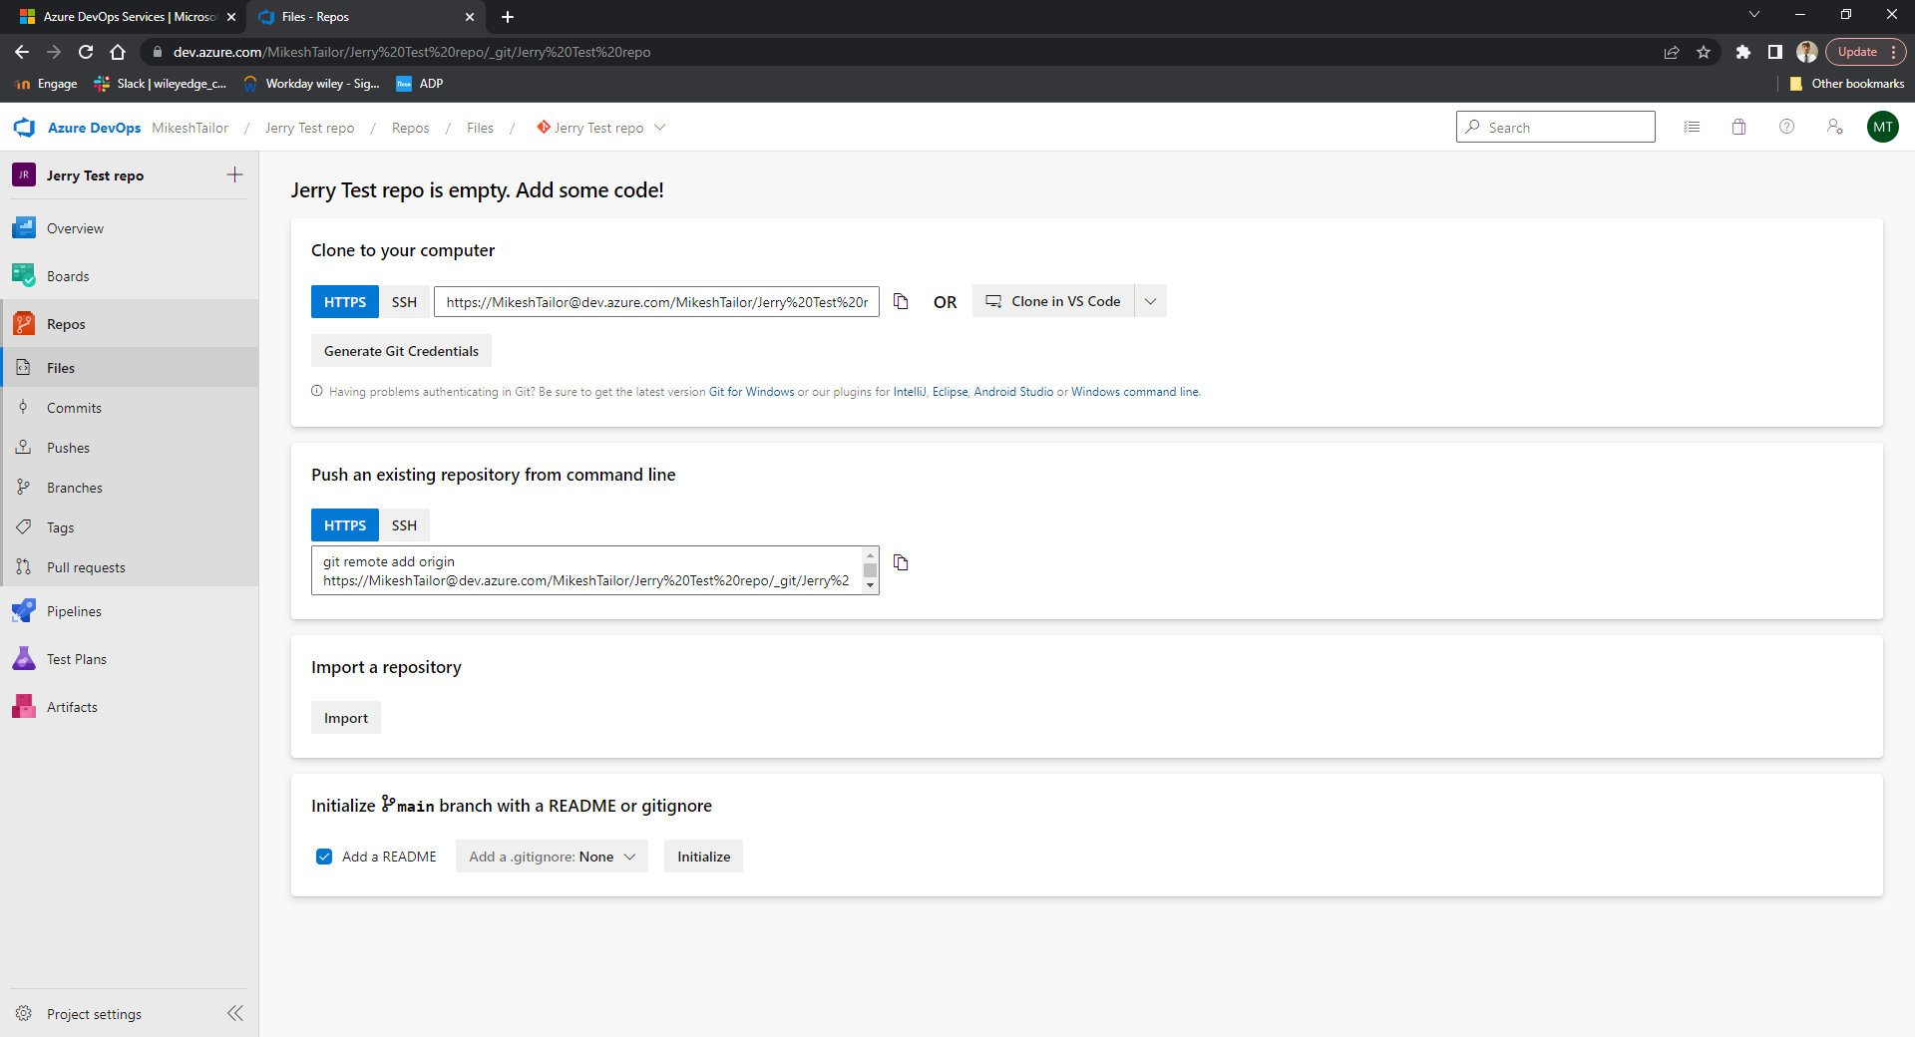
Source code
GIT
Notes:
In azure sorce code is also version controlled by git and if jerry wanted to he could upload his code into a repository from github

Slide 16
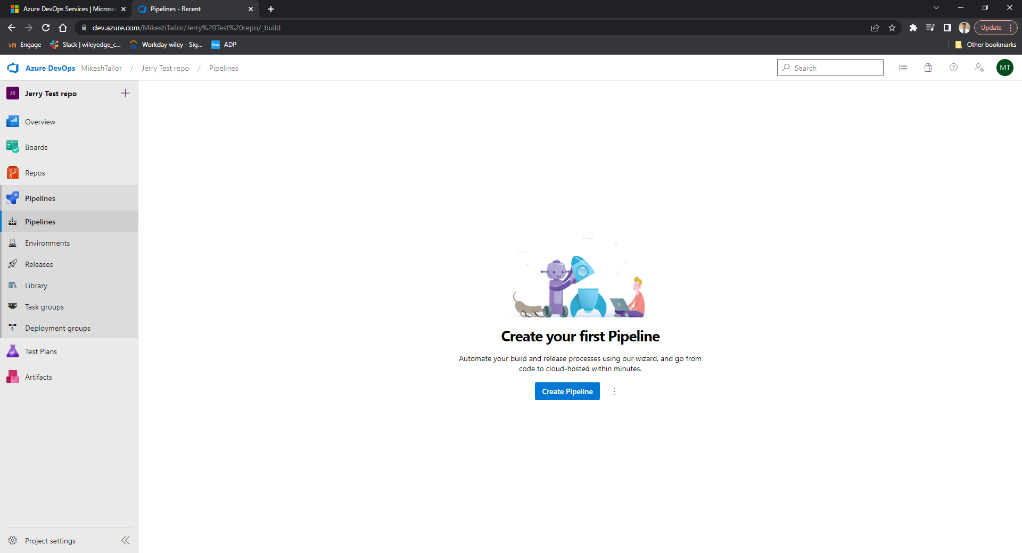
CI/CD Pipeline & Artifacts
Get the source code from the repo
Try to compile
Created something shippable
Assigned a build number
Notes:
Automated builds work by triggers so evertime a new commit is made to the repo that would then trigger a build.
The advantage of this is that if see errors quicker
Artifacts are produced after a successful build
Are later used in the ‘Releases’ section
Releases can then be staged possibly a test and production stage and then jerry can assign his manger to approve before it goes into production and completes a release.
Triggers can also be used here

Slide 17
Summary
Jerry has now have an Ubuntu server created using a Docker image and Dockerfile.
An Apache web server has been created and is running successfully on the Ubuntu server
Source code was uploaded to the web server through the Dockerfile.
The website can be accessed through the web server via localhost.

Slide 18
Future Improvements
Run time page link bug within the Apache2 web server
Using RSA keys instead of using password
Create separate user login with permissions rather than using root.

Slide 19
Thank you for listening Any Final Questions or Feedback?

